Slide 1
CS/IT BSc Projects
Ubiquitous Computing and Interaction

Slide 2
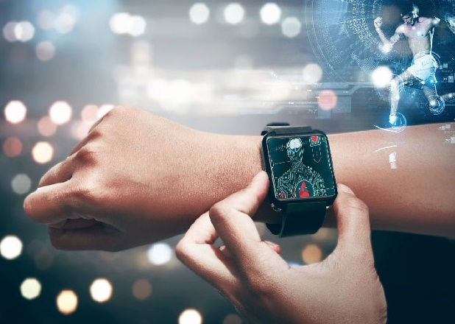
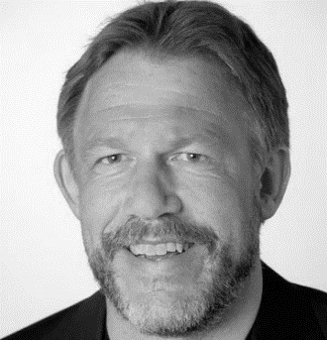
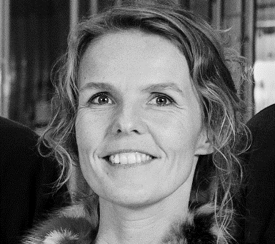
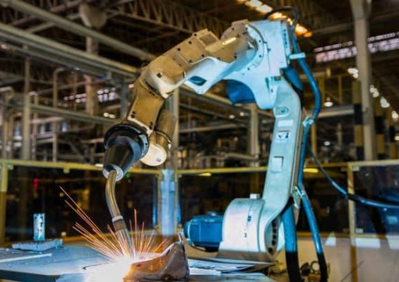
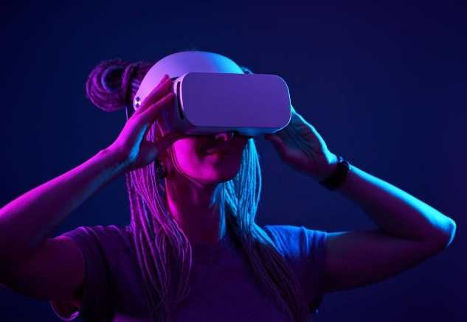
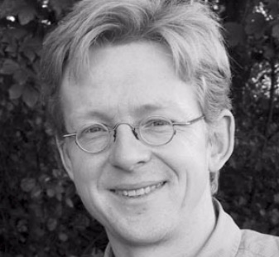
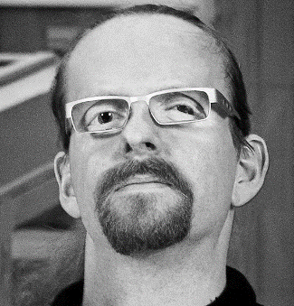


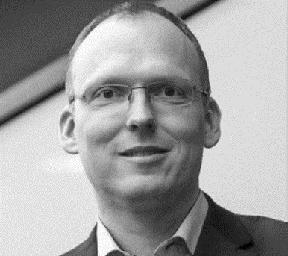
KAJ
MARIANNE
HANS
NIELS OLOF
HANS-JÖRG

Slide 3
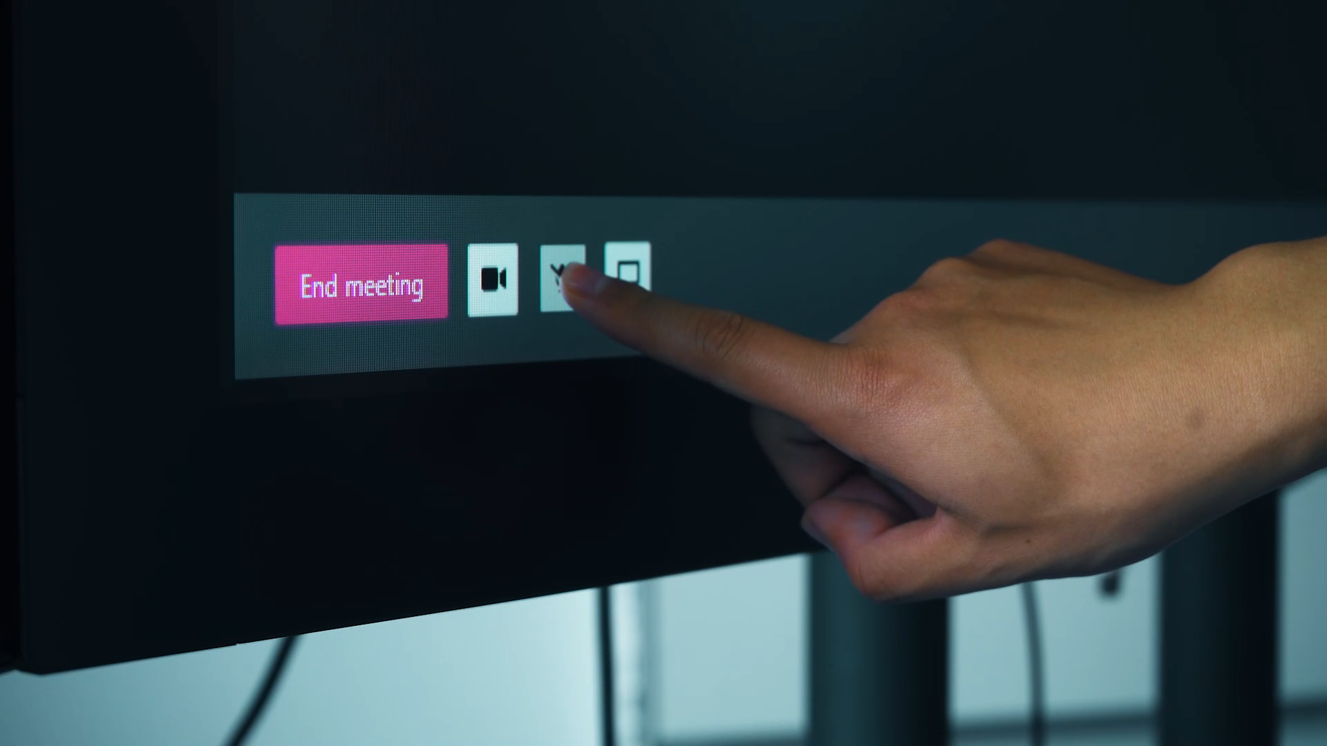
[UBI-A] Communication Cues for Video Conferencing Systems

Slide 4
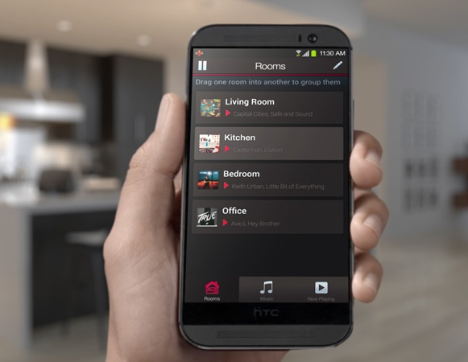
[UBI-K] Seamless Music Streaming
Transitions
Room to Room
Phone to Stereo
Playlist A to Playlist B
Sensors for spatial, temporal, and social context

Slide 5
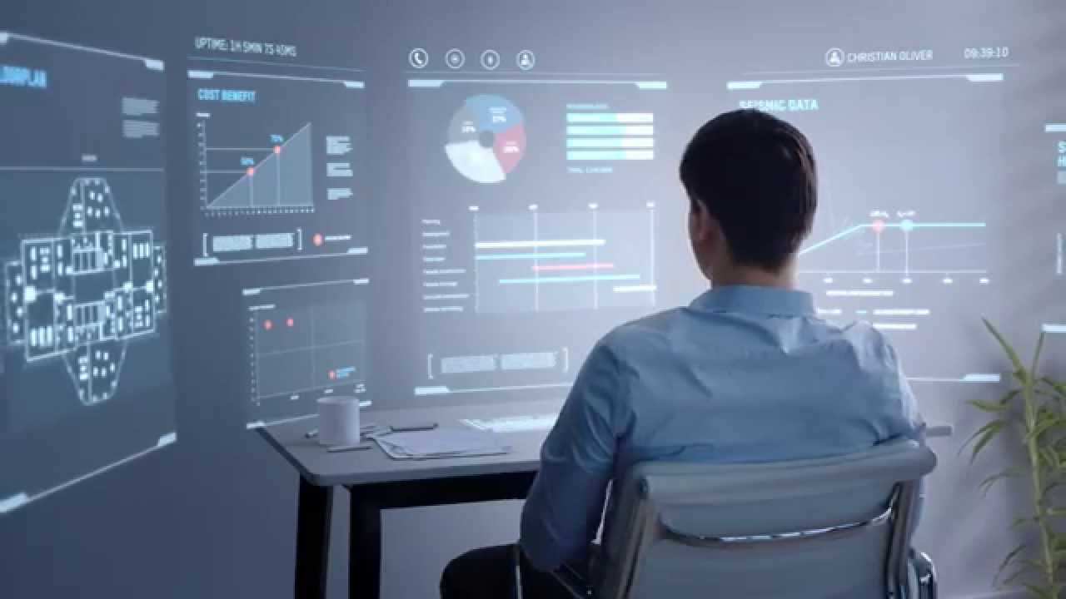
[UBI-L] Office of the Future
Interaction Techniques & Interactive Interiors for
mixed meetings
office@home
shifting collaborations

Slide 6
[UBI-H] Vibrotactile Feedback for Visualization
SteelSeries RIVAL 710
Increase trust / sense of security when interacting with data visualizations

Slide 7
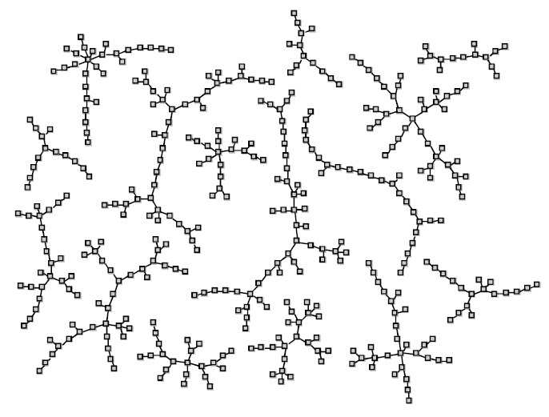
[UBI-C] Reactive Polynomio Packing for Interactive Data Visualization
Extend current polynomio packing heuristics for
dragging
resizing
rotating

Slide 8
UBI BSc Projects
If you want to know more come to the information meeting right after or drop me an email at hjschulz@cs.au.dk.

